Slide 1
𝛴:Sigma Consulting
THE PARTNERTS THAT ADD VALUE TO YOUR COMPANY

Slide 2
Covid Myth Debunking
More people will die out hunger
Most relevant correlation to Covid Deaths are diabities, heart deases and GDP per capita
Richer countries get less covid than poorer
Less concetrated places get less covid deaths

Slide 3
Used Methods
Linear Regression
Multivariable selection
Multiple variable correlation

Slide 4
Sources
Wold Bank API
FAO Data Base
John Hopkins API

Slide 5
Myth 1. More People will die out of hunger
Main Hypothesis: Expected reduction in economic crisis will have a much bigger impact on deaths per million than Covid
Process:
1. Get data sources
2. Find linear regressions on historic deaths per million to proyect figures for 2020-2022
3. Find correlation between nutrition as a proxy to hunger, GDP per capita and deaths per million
4. Project expected incremental deaths based on lower thatn expected GDP per capita
5. Compare Death levels

Slide 6
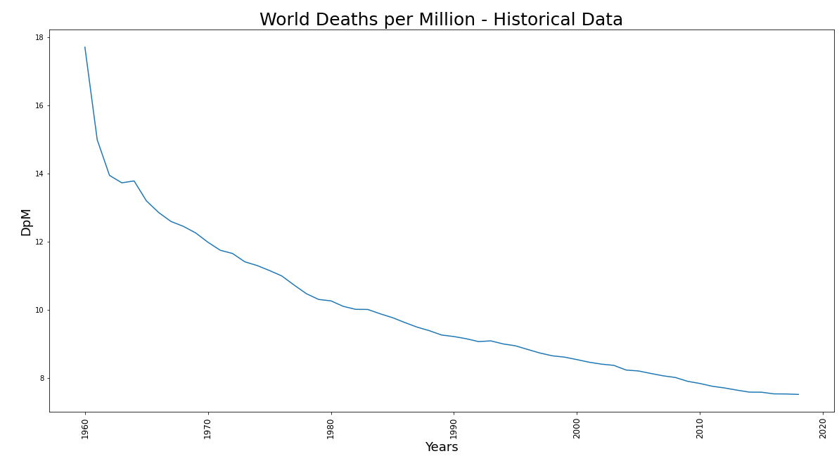
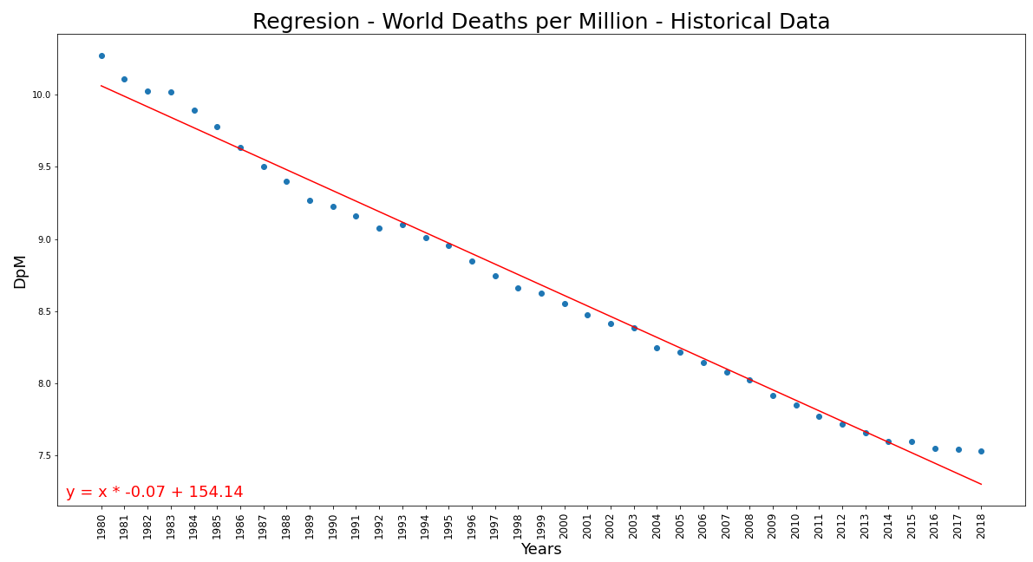
2. Find linear regressions on historic deaths per million to proyect figures for 2020-2022
Y= X*(-.07) + 154.14
R-squared=.9875
Predictions:
2020: 7.15 DpM
2021: 7.08 DpM
2022: 7.01 DpM
The expected Deaths per Million Habitants in the World based on historical data is: 2020: 7.15 2021: 7.08 2022: 7.01

Slide 7
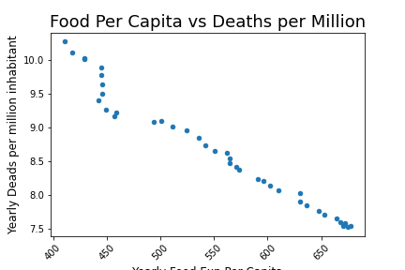
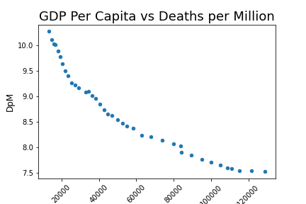
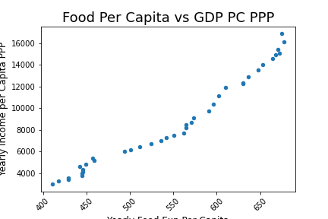
3. Find correlation between nutrition as a proxy to hunger, GDP per capita and deaths per million
Analysis:

Slide 8
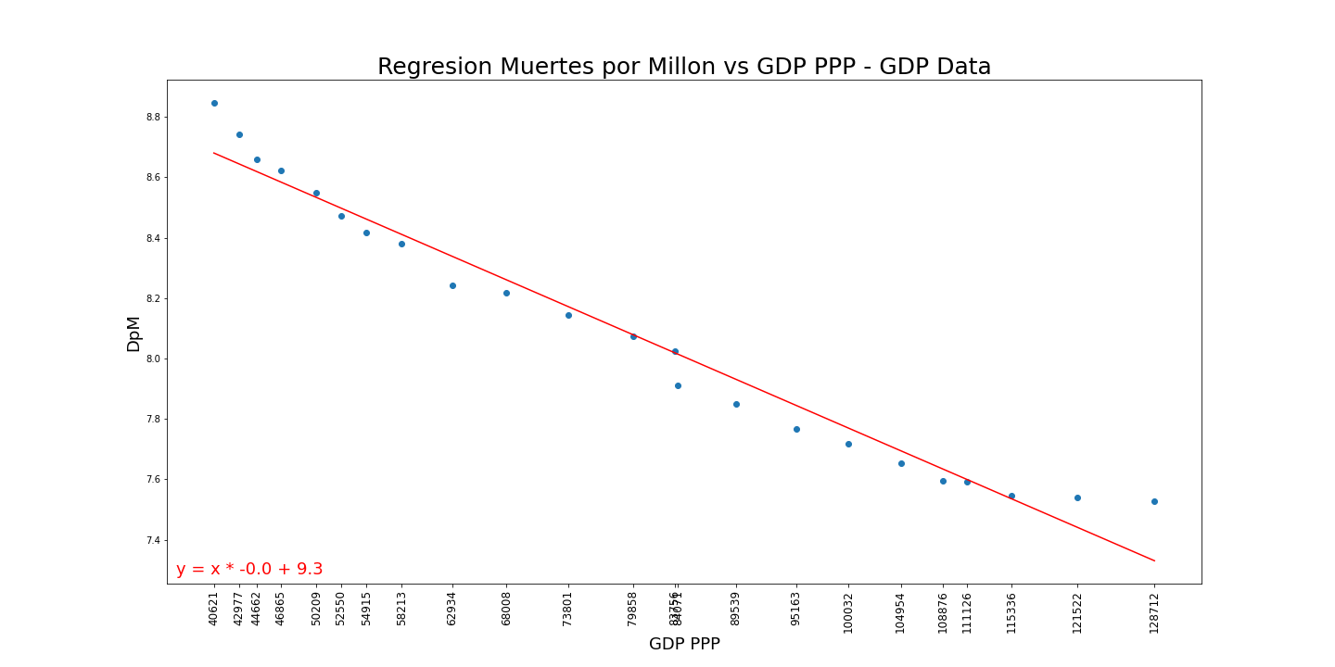
4. Project expected incremntal deaths based on lower than expected GDP per capita
Y= X*(-1.5e-5) + 9.303
R-squared=.9674
Predictions:
2020: 7.31 DpM
2021: 7.16 DpM
2022: 7.03 DpM
Analysis:

Slide 9

5. Compare Death levels
Year | DpM_Historic | DpM_GDP | Delta | Deaths due Crisis
2020 | 7.307578 | 7.152307 | .155271 | 1,195,586
2021 | 7.159862 | 7.079542 | .080320 | 618,465
2022 | 7.031353 | 7.006777 | .024575 | 189,229
Total Deaths by Economical Crisis : 2,003,280

Slide 10
Myth 2-3. Biggest correlating variables on Covid deaths are Diabities and Heart Desease and negative correlation exist to GDP per capita
Main Hypothesis: Countries income will impact in hability to have lower COVID deaths and pleaces with higher Diabeties and Heart deases rates will have a higher Covid death rate
Process:
1. Get data sources
2. Find availiabie variables to find correlations
3. Peforme multivariable analysis to reject not correlatig variables
4. Arrive to conclusions

Slide 11
Myth 4. Cities with higher tempeture will have lower Covid death rates
Main Hypothesis: In places with higher tempatures contagion and thus deast rate is expected to be lower than places with lower average tempature.
Process:
1. Get data sources
2. Find availiabie variables to find correlations
3. Peforme multivariable analysis to reject not correlatig variables
4. Arrive to conclusions

